Slide 1


Department of Electrical and Electronics Engineering
PBL Activity
Polyglot Persistence Approach for a Decentralized News Platform
Course: Database Management System
By
Nishad Dere
Div B, PRN - 1032231906, Batch – G2

Slide 2

Outline
Introduction
Project Aims and Objectives
Background of Project
Software Requirement Specification
Existing Vs Proposed
Software Tool Used
Table Design (if applicable)
ER Diagram(if any)
System Implementation
Results & Discussion
Application
Conclusion & Future Scope
Individual contribution
References
2
DoEEE
8/8/2024

Slide 3
Introduction
MyNews is a prototype web application for a real-time, user-driven news sharing platform.
This project's main goal is to demonstrate a modern database architecture called Polyglot Persistence.
Polyglot Persistence is the concept of using multiple, different database technologies (e.g., SQL and NoSQL) within a single application.
A Relational (SQL) database for one type of data. (USER)
A Document (NoSQL) database for another. (NEWS)
School of Electronics and Communication Engineering
8/8/2024

Slide 4
Project Aims and Objectives
AIM - To design and demonstrate a functional backend system that intelligently uses both SQL and NoSQL databases to solve a real-world problem.
OBJECTIVES –
To use PostgreSQL (SQL) to store structured and relational data (User Accounts)
To use MongoDB (NoSQL) to store flexible, semi-structured data (News Posts, Votes).
To create a Node.js API that connects to both databases and manages data flow.
To demonstrate the specific advantages of each database model (e.g., SQL integrity vs. NoSQL speed)
School of Electronics and Communication Engineering
8/8/2024

Slide 5
BACKGROUND OF PROJECT
Traditional applications often used a monolithic approach, forcing all data types into a single SQL database.
This is inefficient for modern web applications. For a news site:
User Data: Needs to be structured, secure, and have guaranteed unique usernames. This is perfect for SQL.
Post Data: Needs to be flexible (to add comments, tags later) and handle high-frequency updates (like upvotes). This is a poor fit for SQL, which would suffer from row-locking and slow performance.
School of Electronics and Communication Engineering
8/8/2024

Slide 6
Software Requirement Specification
Backend: Node.js (v18+) with Express.js
SQL Database: PostgreSQL
NoSQL Database: MongoDB
Database Libraries: pg (for PostgreSQL), mongoose (for MongoDB)
Frontend: HTML5, CSS3, and modern JavaScript (Fetch API)
Development Tools: Visual Studio Code, nodemon
Database Viewers: pgAdmin (for PostgreSQL) and MongoDB Compass (for MongoDB)
School of Electronics and Communication Engineering
8/8/2024

Slide 7
Existing Vs Proposed
Existing (Monolithic) Approach:
Store everything (users and posts) in SQL.
Problem: Every upvote would be a slow UPDATE operation that could lock the post's row, causing bottlenecks. The schema for posts would be rigid and complex.
Proposed (Polyglot) Approach:
Users in PostgreSQL (SQL): Guarantees data integrity. We use a UNIQUE constraint to prevent duplicate usernames.
Posts in MongoDB (NoSQL): Highly flexible schema. Upvoting is an extremely fast, atomic $inc operation that doesn't lock the document.
Result: High integrity for users, high speed and flexibility for posts.
School of Electronics and Communication Engineering
8/8/2024

Slide 8
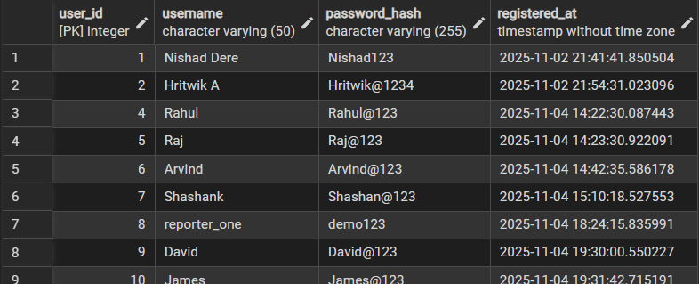
Table Design (SQL)
- Table Name: users.
- Schema:
user_id: (SERIAL, PRIMARY KEY) - Automatically increments.
username: (VARCHAR, UNIQUE, NOT NULL) - Enforces no duplicate users.
password_hash: (VARCHAR, NOT NULL) - Stores the user's password.
registered_at: (TIMESTAMP) - Automatically set to the current time.
School of Electronics and Communication Engineering
8/8/2024

Slide 9
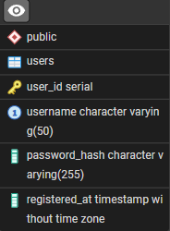
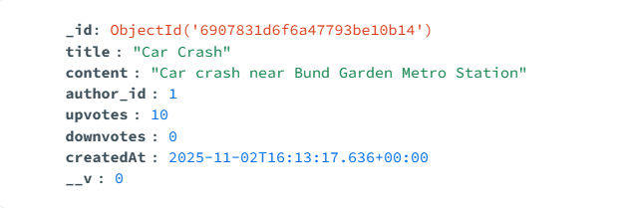
ER Diagram
Author_id
School of Electronics and Communication Engineering
8/8/2024

Slide 10
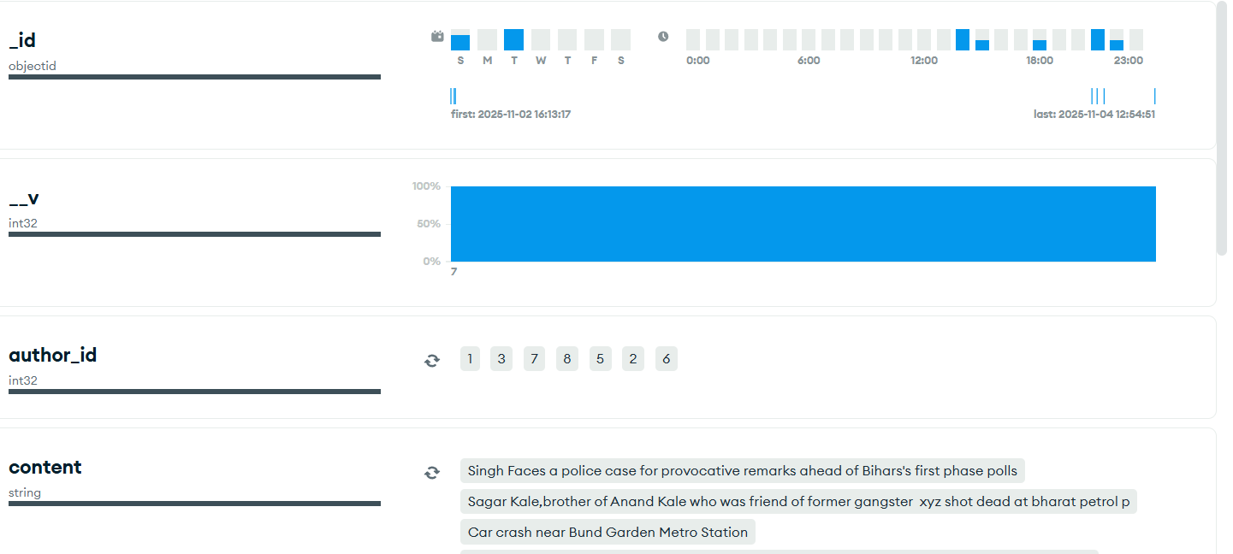
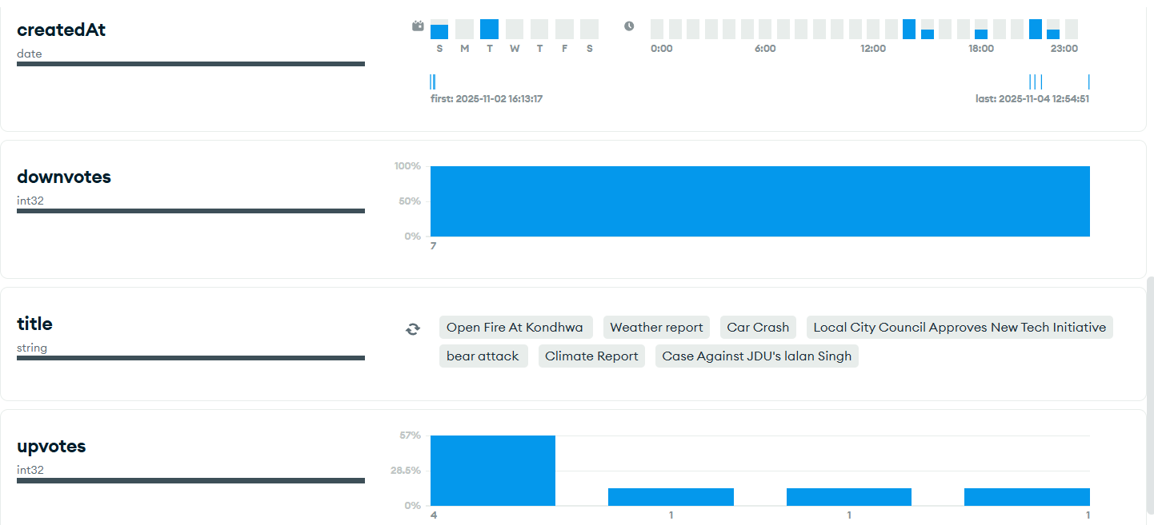
Schema
School of Electronics and Communication Engineering
8/8/2024

Slide 11
Document Design (NoSQL)
-Collection Name: posts
Document Structure
The author_id (Number) is the logical link that references the user_id in our PostgreSQL users table.
School of Electronics and Communication Engineering
8/8/2024

Slide 12
System Implementation
First, it SELECTS from PostgreSQL to check if the author_id is valid.
-The system is a Node.js backend with several key API endpoints:
/register (POST):
Takes username and password.
Runs an INSERT query into the PostgreSQL users table.
/login (POST):
Takes username and password.
Runs a SELECT query on the PostgreSQL users table to verify credentials.
/posts (POST):
POLYGLOT LOGIC:
First, it SELECTS from PostgreSQL to check if the author id is valid.
If valid, it INSERTs the new post document into the MongoDB posts collection.
/posts/:id/upvote (PUT):
Runs an atomic findByIdAndUpdate command in MongoDB using $inc to instantly increase the upvotes count.
School of Electronics and Communication Engineering
8/8/2024

Slide 13
Application & Conclusion
First, it SELECTS from PostgreSQL to check if the author_id is valid.
- Application:
This architecture is the standard for almost all modern, large-scale web applications.
Examples: E-commerce sites (users/orders in SQL, product catalogs/reviews in NoSQL), social media, and IoT platforms.
- Conclusion:
The "one size fits all" database model is obsolete.
Polyglot Persistence, as demonstrated by the MyNews project, provides a faster, more scalable, and more resilient solution for modern applications.
We successfully proved that SQL and NoSQL can be used together to build a superior system.
School of Electronics and Communication Engineering
8/8/2024

Slide 14
Future Scope
First, it SELECTS from PostgreSQL to check if the author_id is valid.
- Full User Authentication: Implement real password hashing (using bcrypt) instead of storing plain text.
- Expand NoSQL Schema: Add a comments array directly inside the MongoDB post document, showing its flexibility.
- Cloud Deployment: Deploy the application to the public internet using cloud services (e.g., Render for the backend, MongoDB Atlas, and a cloud PostgreSQL provider).
School of Electronics and Communication Engineering
8/8/2024

Slide 15
REFERENCES
First, it SELECTS from PostgreSQL to check if the author_id is valid.
-https://nodejs.org/en/docs/
-https://www.mongodb.com/docs/
-https://www.postgresql.org/docs/
School of Electronics and Communication Engineering
8/8/2024

Slide 16
School of Electronics and Communication Engineering
8/8/2024

Slide 18
School of Electronics and Communication Engineering
8/8/2024

